Slide 1


US Air Quality Analysis
Ashwin Jain
Kelvin Ramos
Jayashree Kotte

Slide 2

Why Air Quality?
Problem 1
Problem 2
Problem 3
Air pollution is the fourth leading risk factor for early death, contributing to over 7 million (1 out of 8) deaths, as estimated by the WHO.
Up to 99% of us are breathing polluted air, cutting lives short by an average of 2.2 years across the globe.
It is associated with acute and chronic cardiovascular, respiratory illnesses, lung cancer, diabetes and poor birth outcomes.
As per a WHO report, Air Pollution and Child Health, estimated that outdoor and indoor air pollution resulted in 543,000 deaths in children under the age of 5 years in 2016.

Slide 3
Addressing Air Quality
Addressing Air Quality can have many benefits, including the following,
More stable climate
Improved Food Security
Healthier Ecosystem
Greater Social Equity
Stronger Economies
Clearer Views

Slide 4
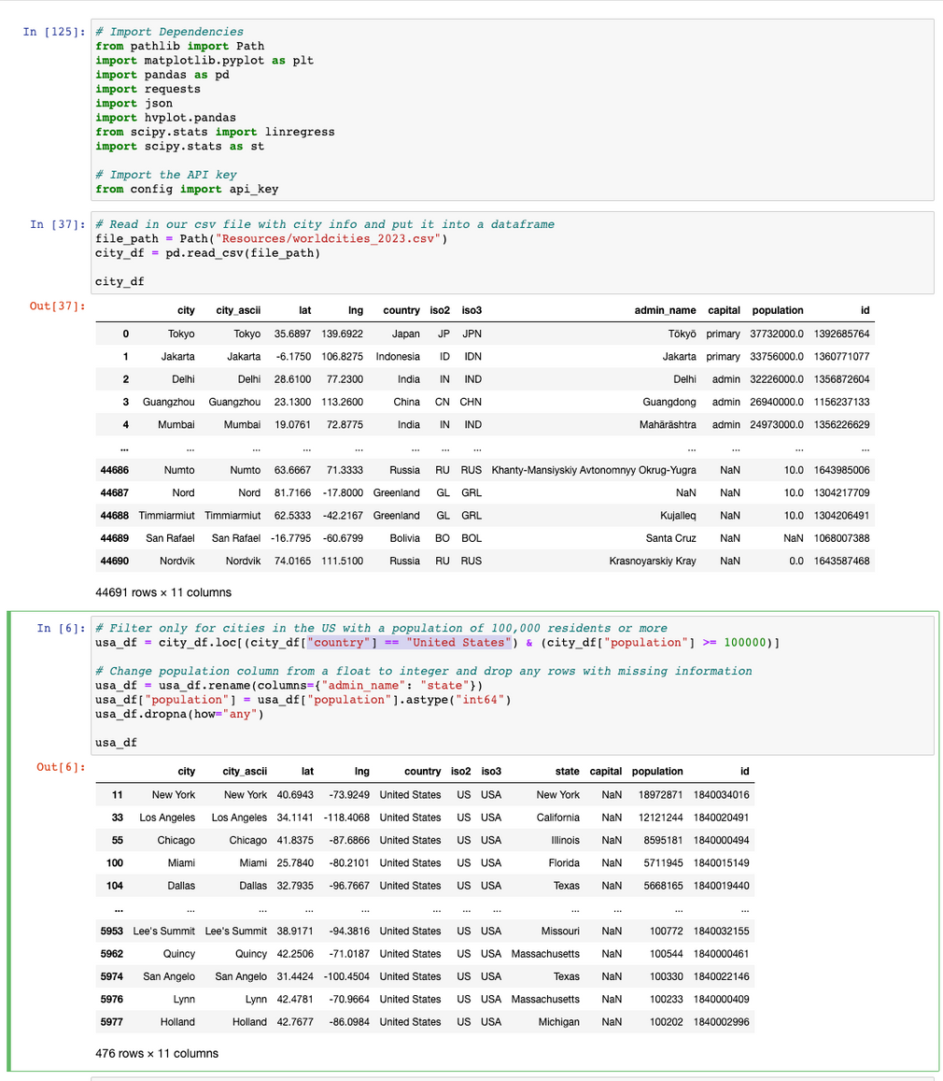
Code
We got world wide city data and extracted only the United States cities to start our analysis.

Slide 5
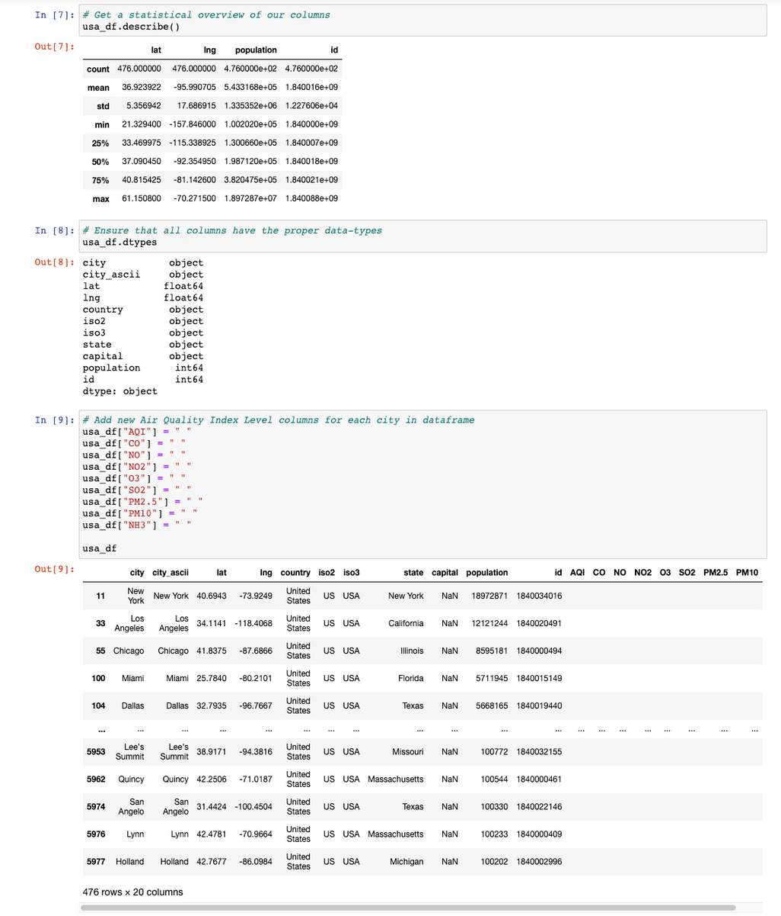
Code
Got a statistical overview of the dataframe and created new columns for Air Quality attributes,
AQI - Air Quality Index
CO - Carbon Monoxide
NO - Nitric Oxide
NO2 - Nitrogen Dioxide
O3 - Ozone
SO2 - Sufur Dioxide
PM2.5 - Paticulate Matter 2.5
PM10 - Particulate Matter 10
NH3 - Ammonia

Slide 6
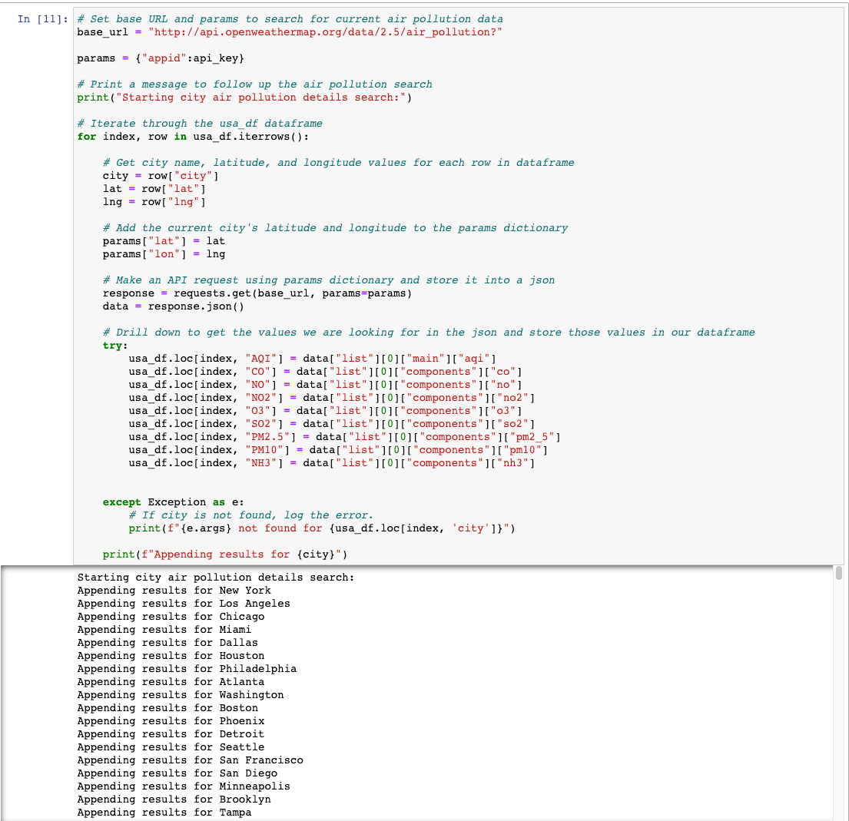
Code
Fetched the real-time air pollution data from Open Weather Map website. Extracted the various air quality attributes and appended them to the usa dataframe.

Slide 7
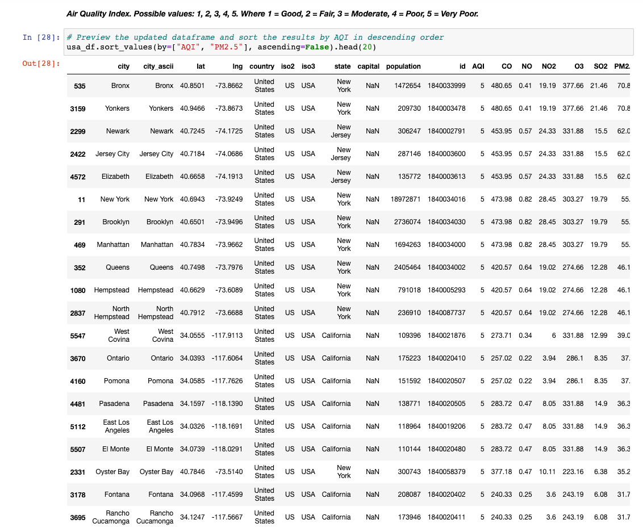
Code
Dataframe sorted by descending values of AQI, to help see which cities have the highest Air Quality Index

Slide 8
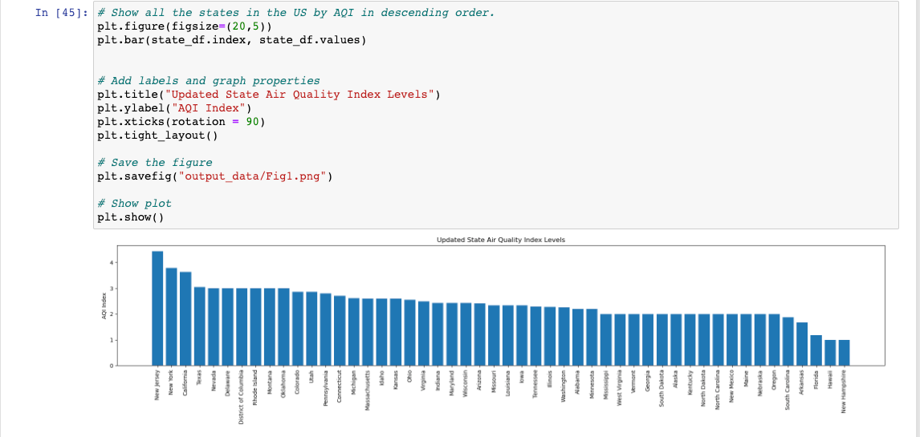
Code
Here we have the chart representing the states and the respective Air Quality Index

Slide 9
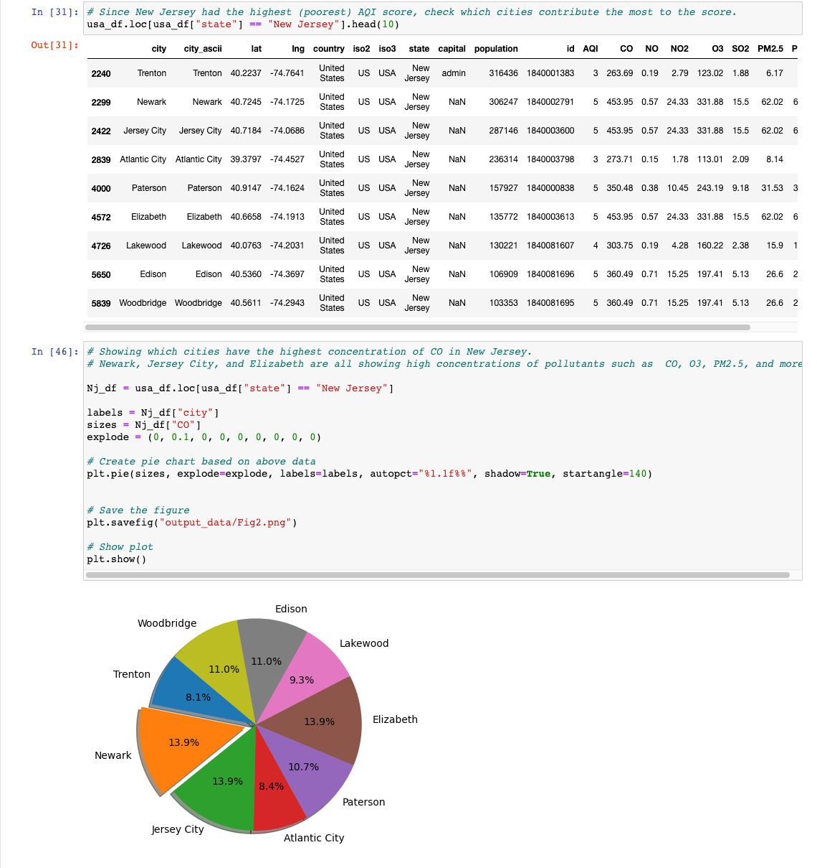
Code
Here, we have an example of an independent state ("New Jersey") analysis as it is one of the most polluted states in the US.
Only the city of Newark was exploded to aid in visualization.

Slide 10
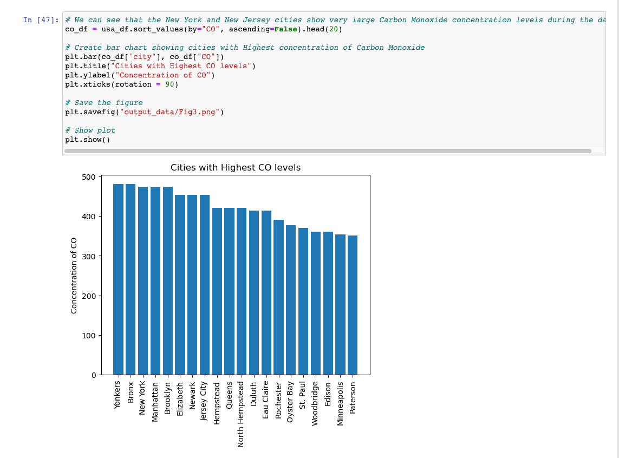
Code
Here we have the chart representing the different cities and the respective CO (Carbon Monoxide) levels

Slide 11
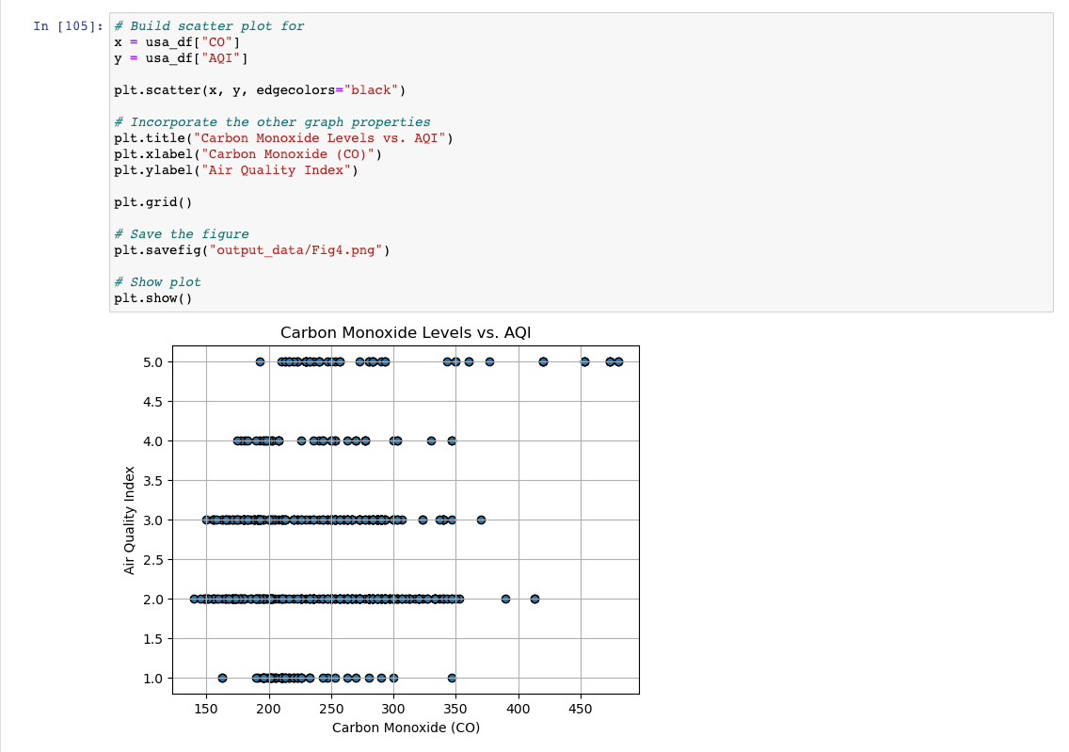
Code
Here, we have the chart representing CO (Carbon Monoxide) levels and the AQI

Slide 12
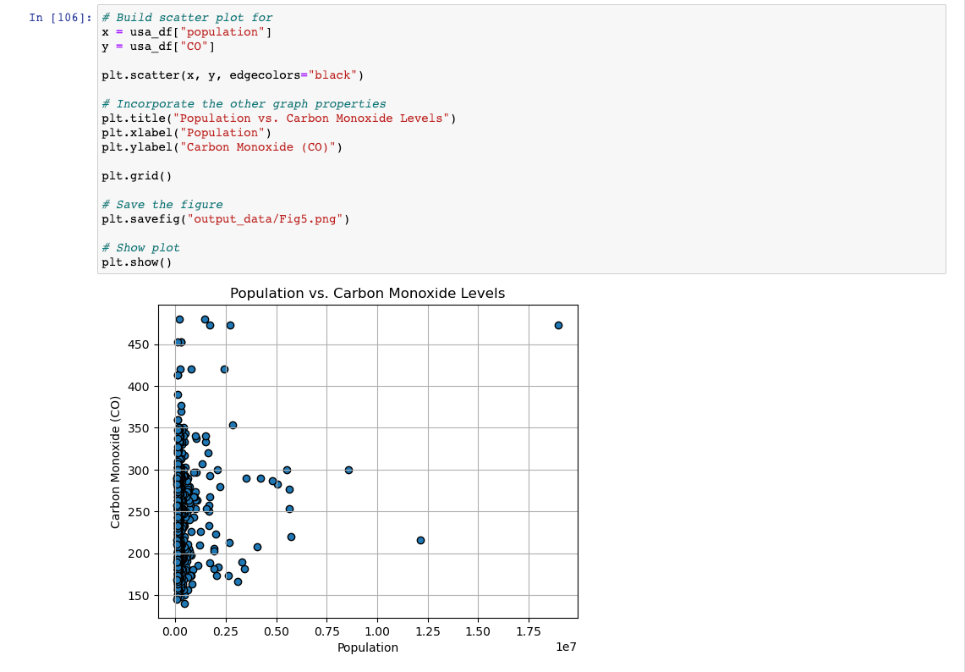
Code
Here, we have the chart representing the population in different cities and the respective CO (Carbon Monoxide) levels

Slide 13
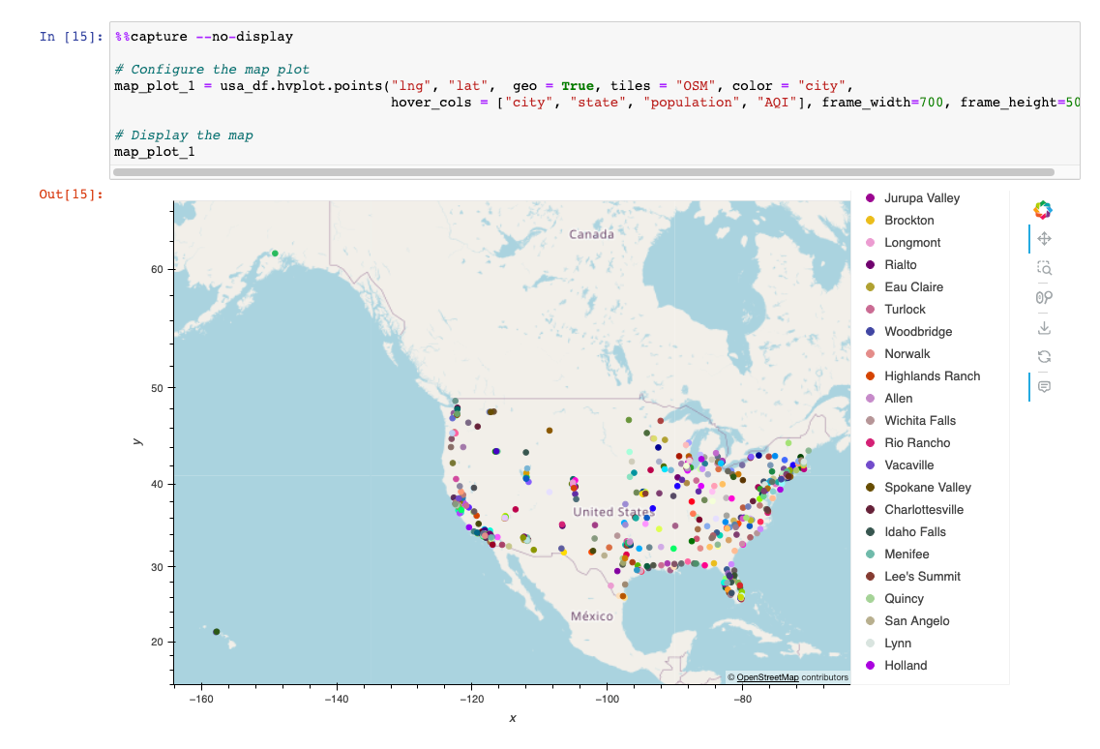
Map View
Here, we have a consolidated map view of the various cities in the US, including the city name, state name, population and AQI value.

Slide 14

Solutions
Renewable fuel and clean energy production
Energy conservation and efficiency
The most basic solution for air pollution is to move away from fossil fuels, replacing them with alternative energies like solar, wind and geothermal.
Producing clean energy is crucial. But equally important is to reduce our consumption of energy by adopting responsible habits and using more efficient devices.
Eco-friendly transportation
Green building
Shifting to electric vehicles and hydrogen vehicles, and promoting shared mobility (i.e carpooling, and public transports) could reduce air pollution.
From planning to demolition, green building aims to create environmentally responsible and resource-efficient structures to reduce their carbon footprint.

Slide 15
THANK YOU

